Slide 1


Slide 2
Step-by-step Guide on How to Use
A Universal Laser Cutter (T1442)

Slide 3
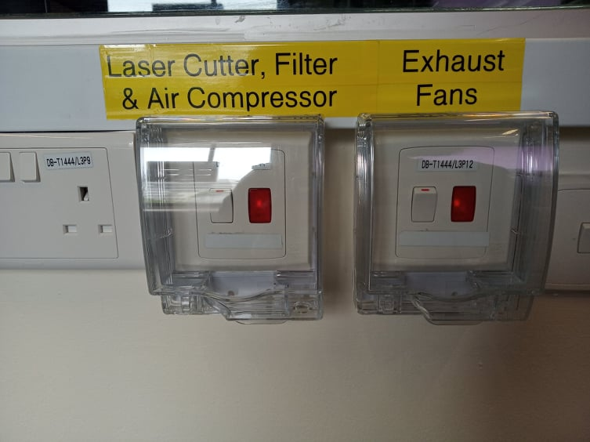
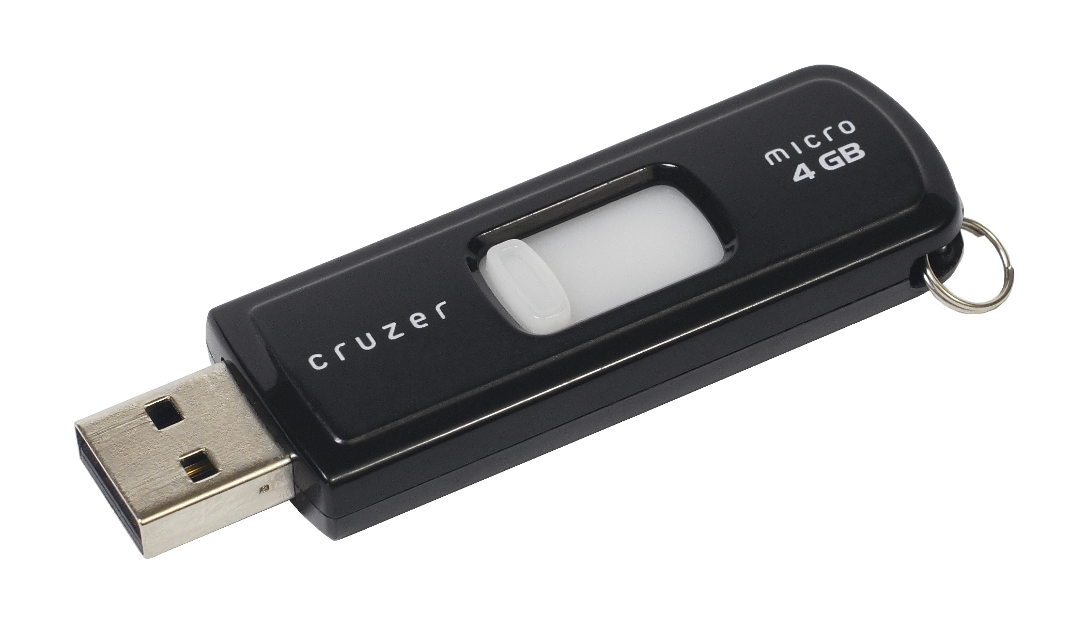
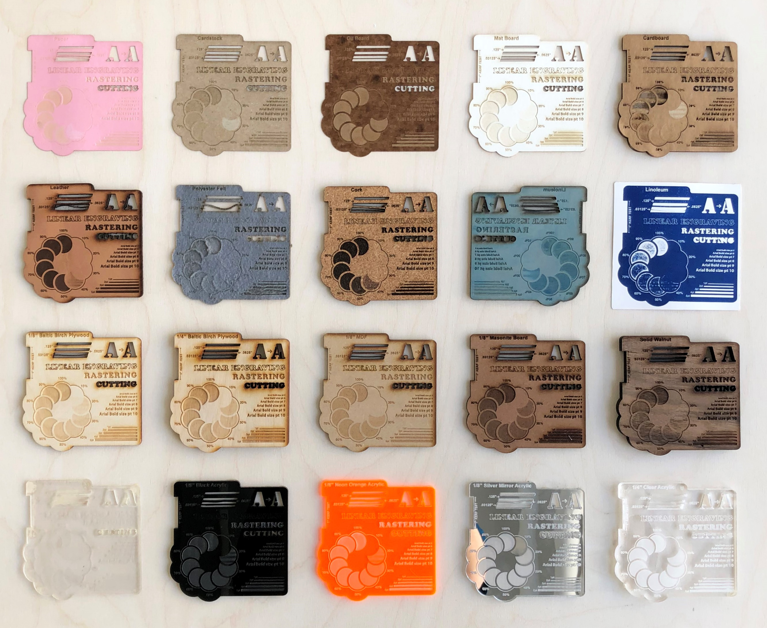
Step 1 (Before Laser Cutting)
Make sure that the main switches of laser cutter and exhaust fans are turned on.
Get your files ready in a thumb drive.
(Acceptable file formats dxf, dwg, svg or pdf. Image files are acceptable also)
3. Make sure that you have enough material for your cutting.

Slide 4
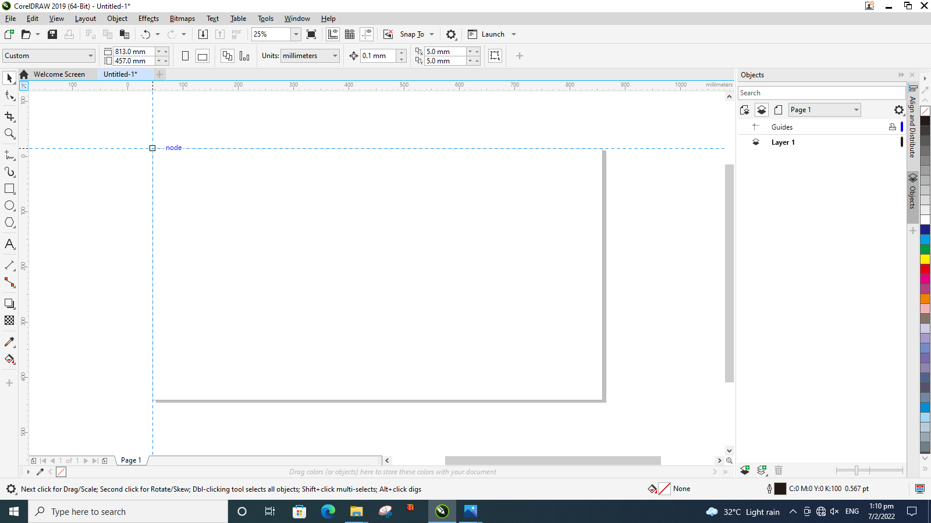
Step 2
Open CorelDraw. Then set the top left corner of the canvas as (0, 0) coordinate. You can do so by going to the icon at the top left corner and dragging to the corner of the canvas.

Slide 5
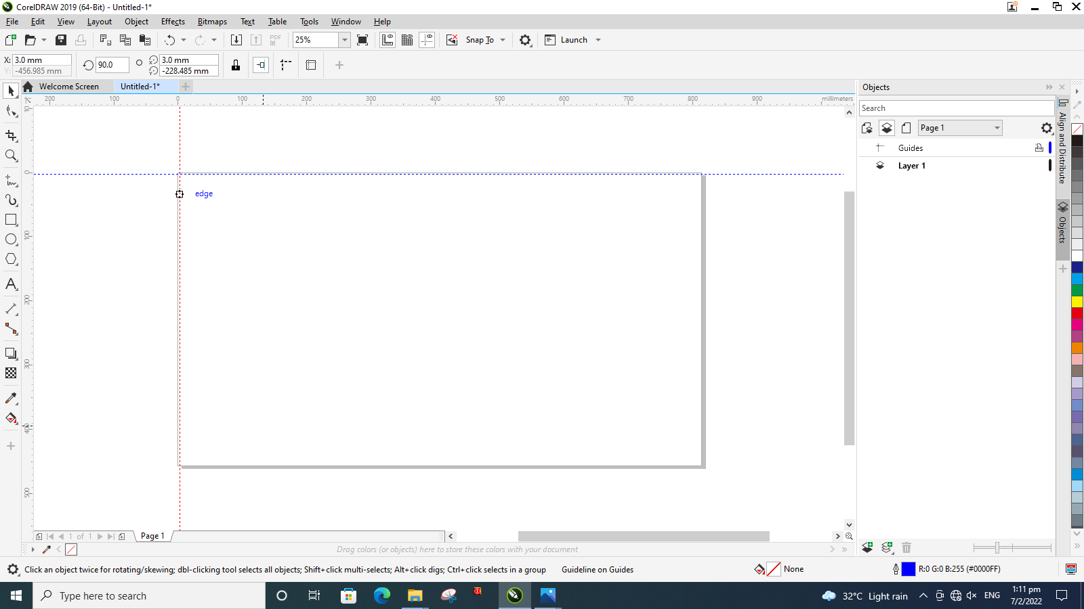
Step 3
Setup guidelines by dragging the horizontal and vertical rulers. Guidelines helps arrange drawings and reduces taking up additional material space. You can check the position of the guidelines by clicking on it. The coordinates can be seen at the top left corner.
COORDINATE
GUIDLINES

Slide 6
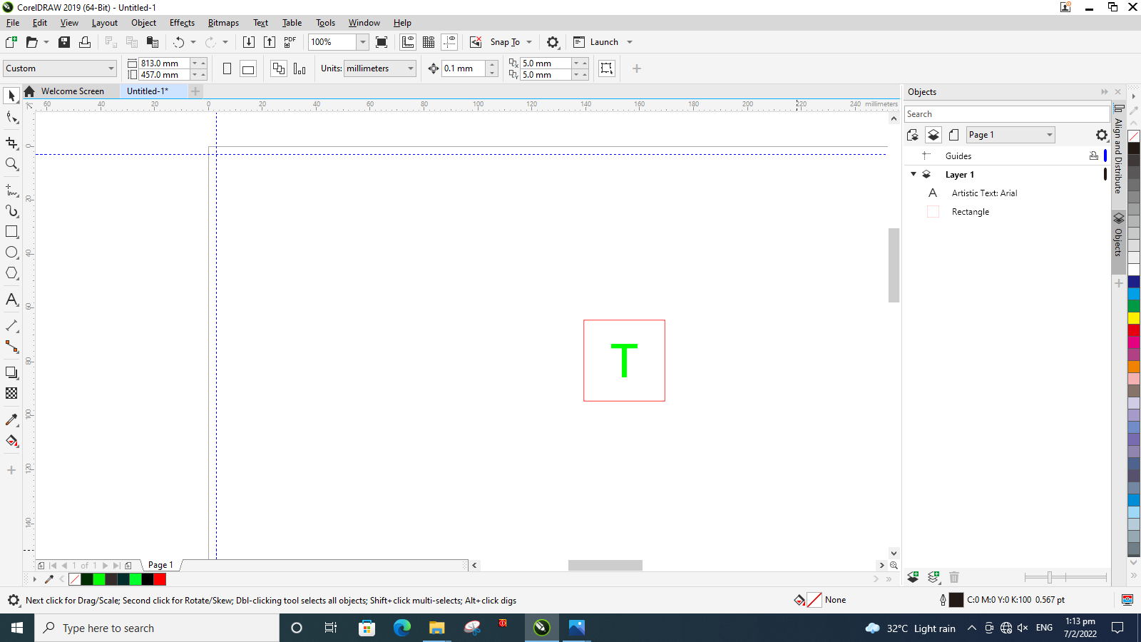
Step 4
Import your file into CorelDraw. Make sure that the file is in one of the formats. (dxf, dwg, svg, pdf and/ or image file(s))
Note: Image files should be in jpg, jpeg or png format. Otherwise, the file will be corrupted when imported into CorelDraw.

Slide 7
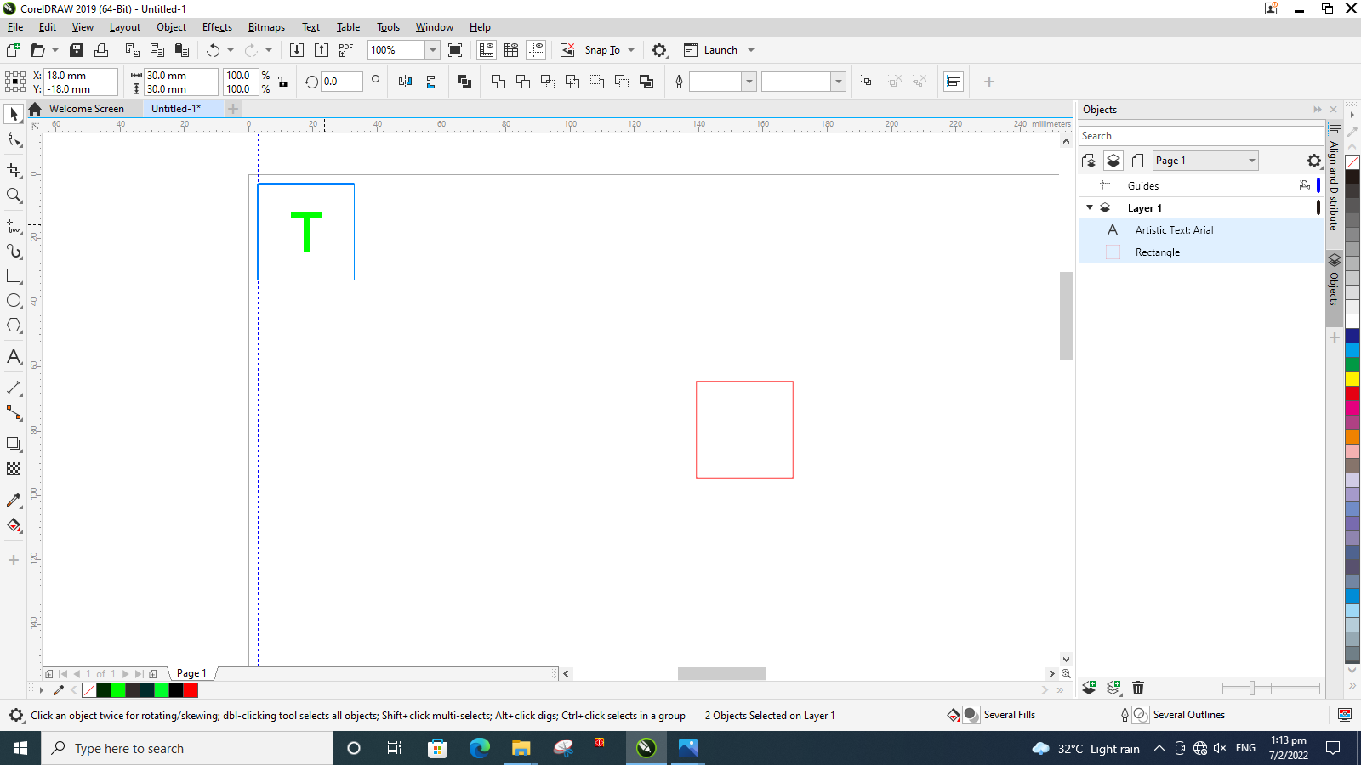
Step 5
Move the imported file to the guidelines. You will see the snap line when the drawing is touching the guidelines. If the snap lines do not appear, make sure that the guideline checkbox has been checked under “Snap To” drop down.
SNAP LINES

Slide 8
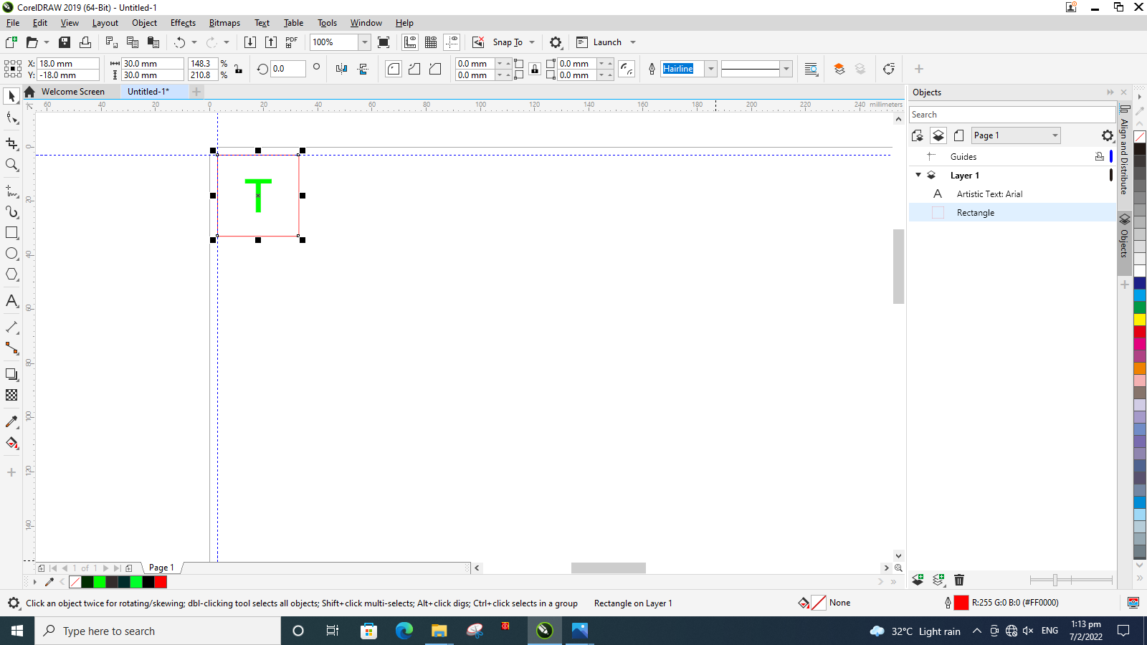
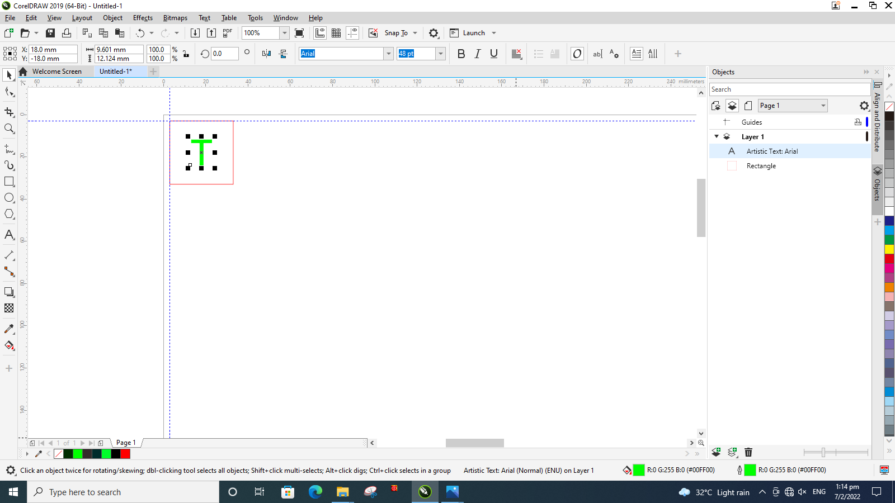
Step 6
Make sure that the line(s) and object(s) have the correct line color and thickness for different cutting settings.
For vector cutting
Lines should be in red, and thickness should be in hairline.
For raster engraving
Line thickness can be anything other than “None” or “Hairline”. Object(s) color should be in green.

Slide 9
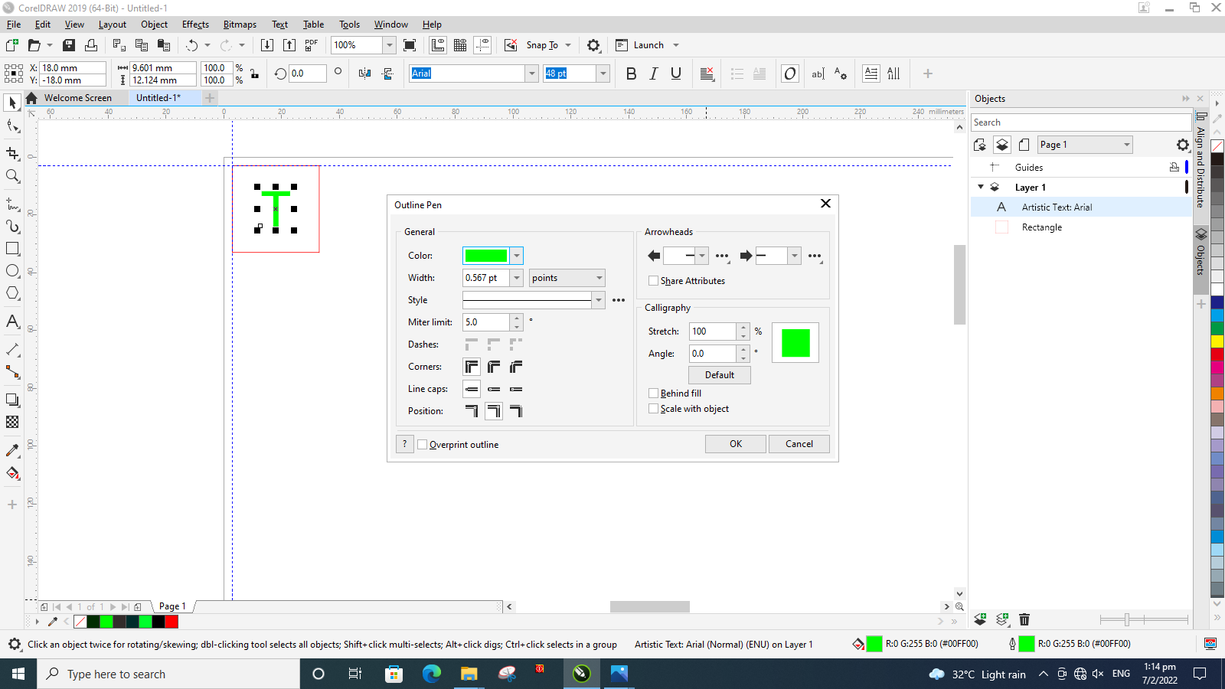
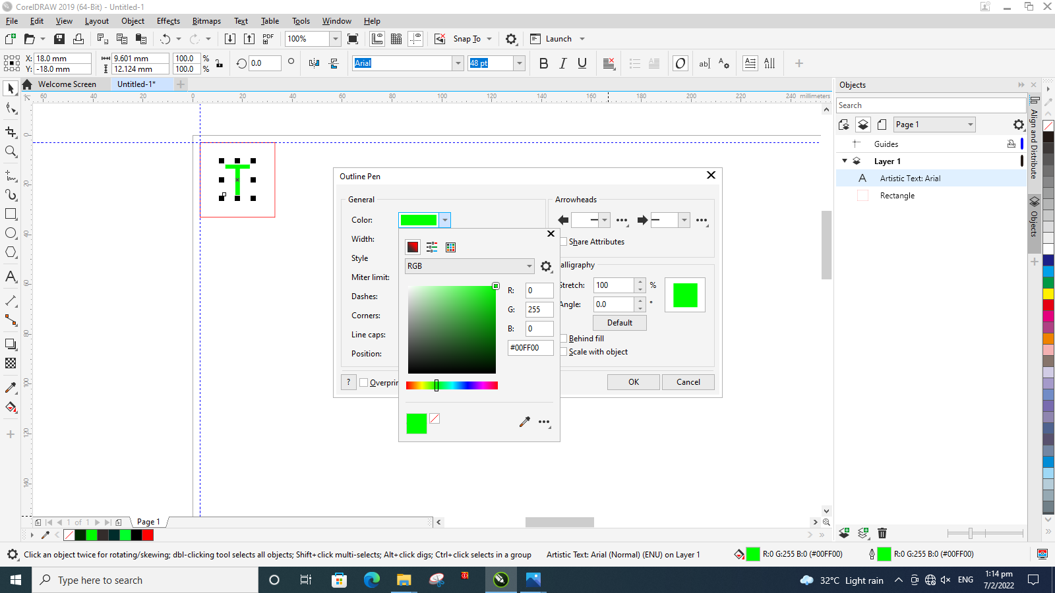
Step 7
You can change the outline color, infill color and line thickness of your line(s) and object(s) by clicking twice at the two icons at the bottom right.
LINE COLOUR
LINE THICKNESS
CHANGE INFILL COLOUR
CHANGE OUTLINE COLOUR
COLOUR FORMAT SHOULD BE IN RGB
The object was meant to engrave; therefore, green was set at the maximum and the rest were set at zero.

Slide 10
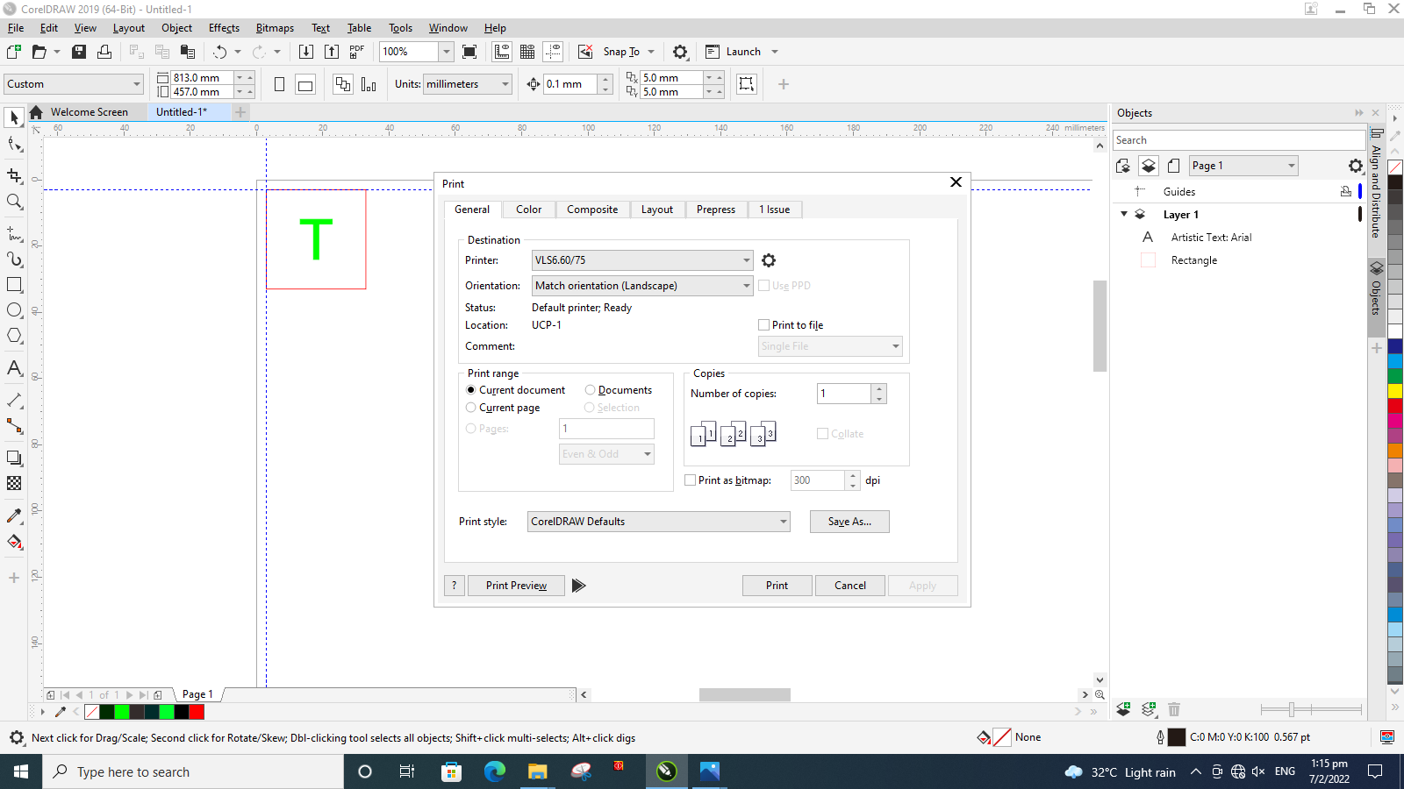
Step 8
When the drawing is ready for printing click “Print” and a menu will pop up. Click the “Setting” icon.

Slide 11
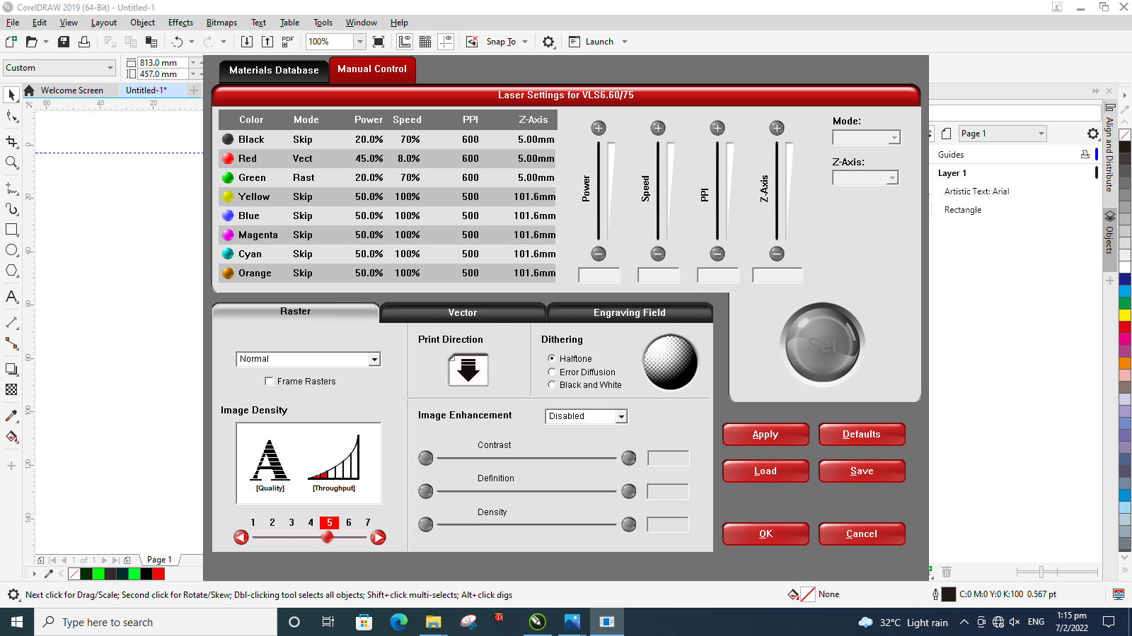
Step 9
A new menu will pop up. Click the “Load” button to load the pre-set cutting settings. This is recommended if you are not familiar with the laser cutting procedures.

Slide 12
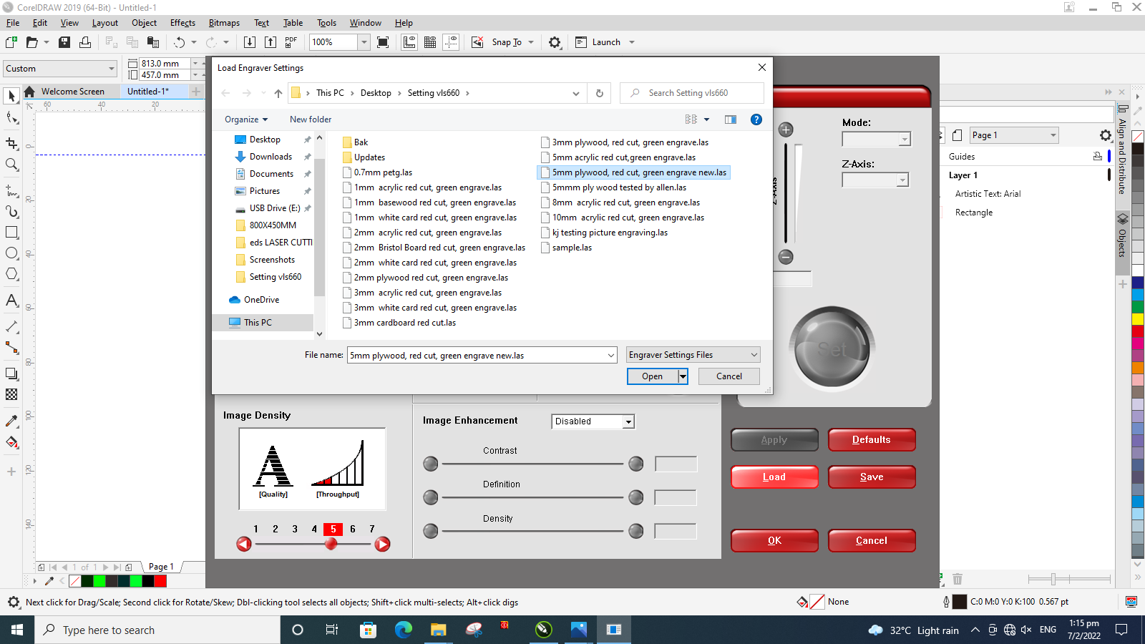
Step 10
A list of materials will show up. Select the materials that you will be using. Here “5mm plywood” is chosen as an example.

Slide 13
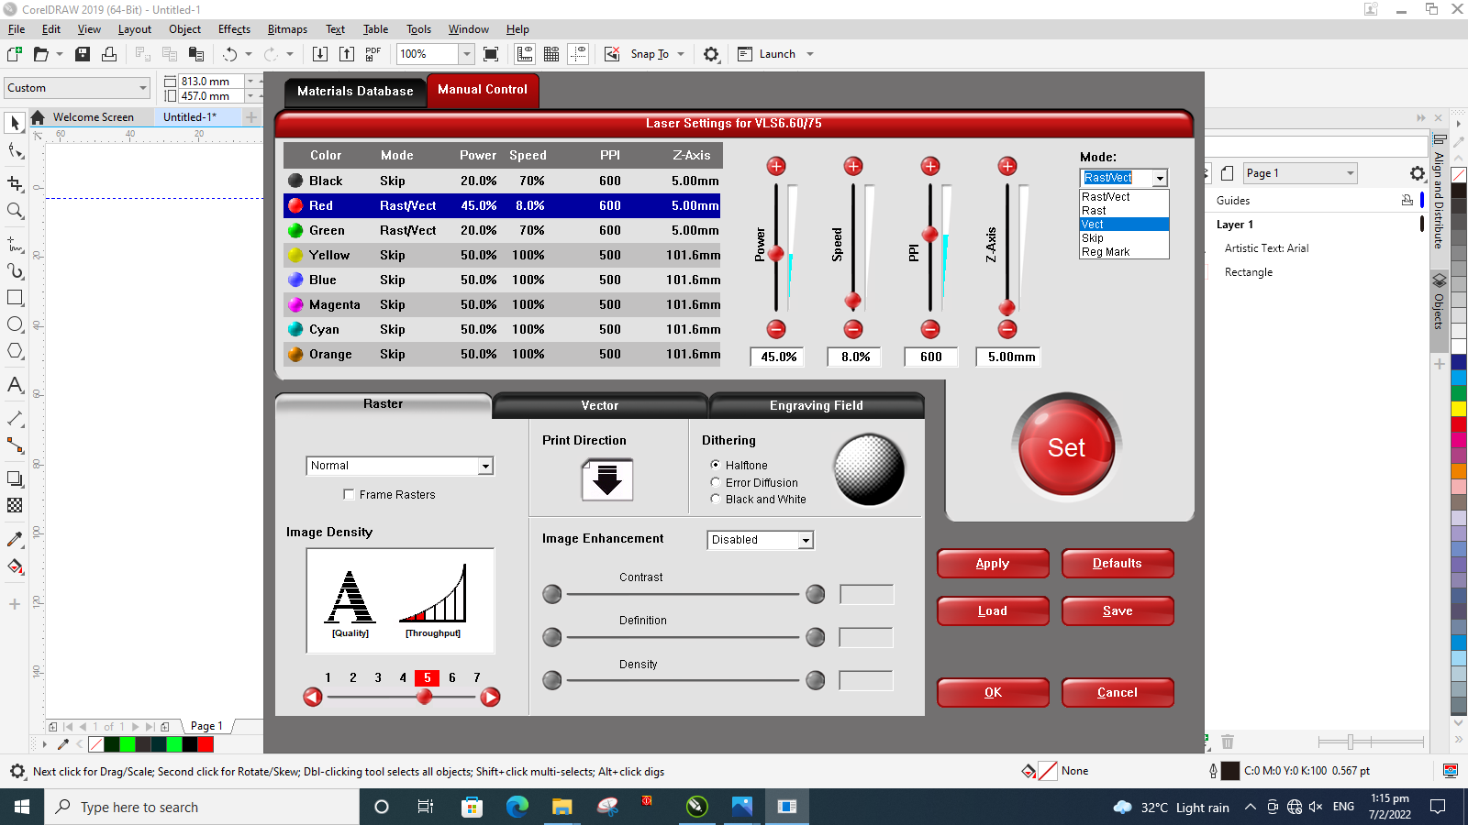
Step 11
After the settings have been loaded, double check whether the colors has the correct cut settings or not. Here, red is originally set as “Rast/Vect”. In the drawing, red is meant for vector cutting so it was changed to “Vect”. After changing, click “Set”.
2
1
3

Slide 14
Step 12
You will need to skip the colors that you are not using. Here, all colors except “Red” and “Green” are skipped. After the settings has been confirmed, click “Apply” then “OK”.
1
2

Slide 15
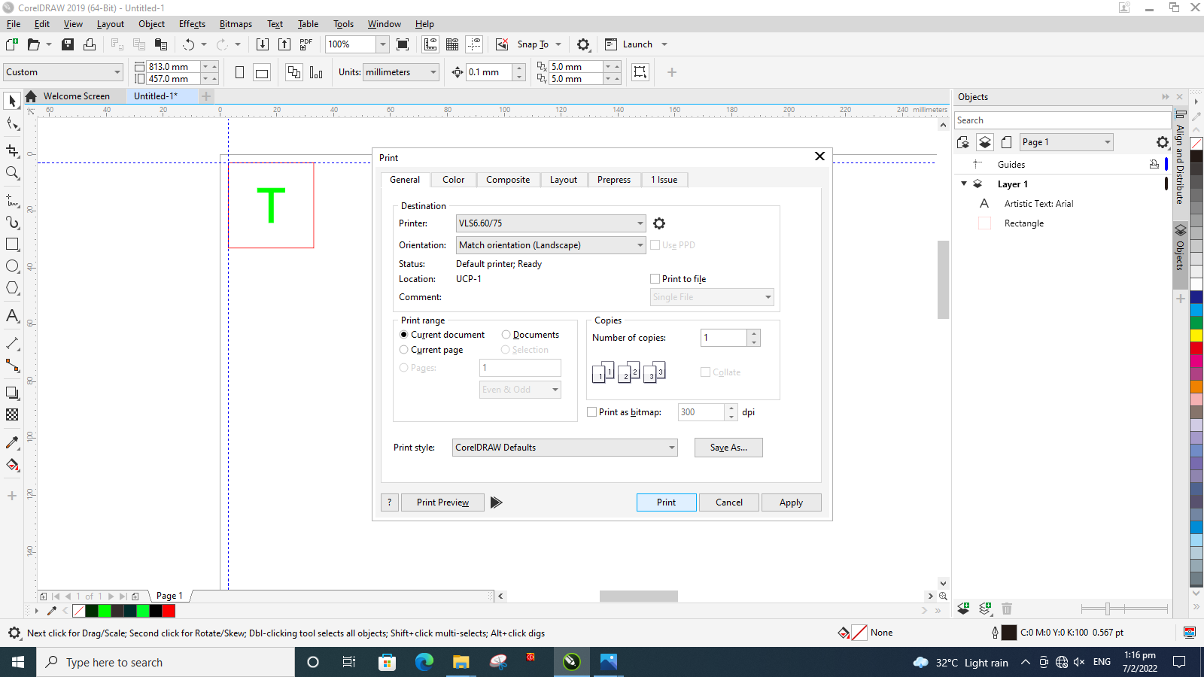
Step 13
You will be brought back to this menu. Click “Print”. You will see another program open. If it does not open automatically, click twice on the red icon beside the CorelDraw icon in the task bar.

Slide 16
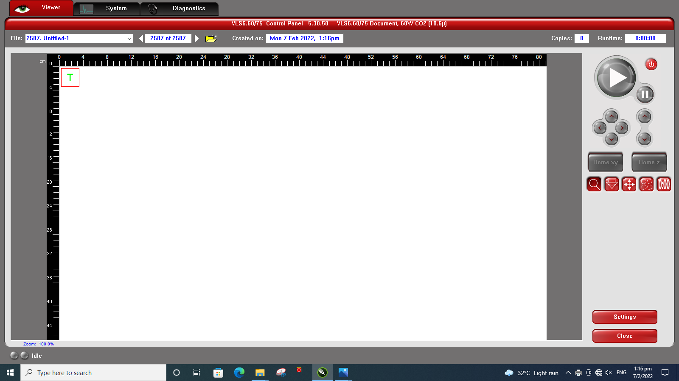
Step 14
You will be brought to this environment. Here, you can see the position of the drawing on the material, cutting time and move drawing to the desired location.

Slide 17
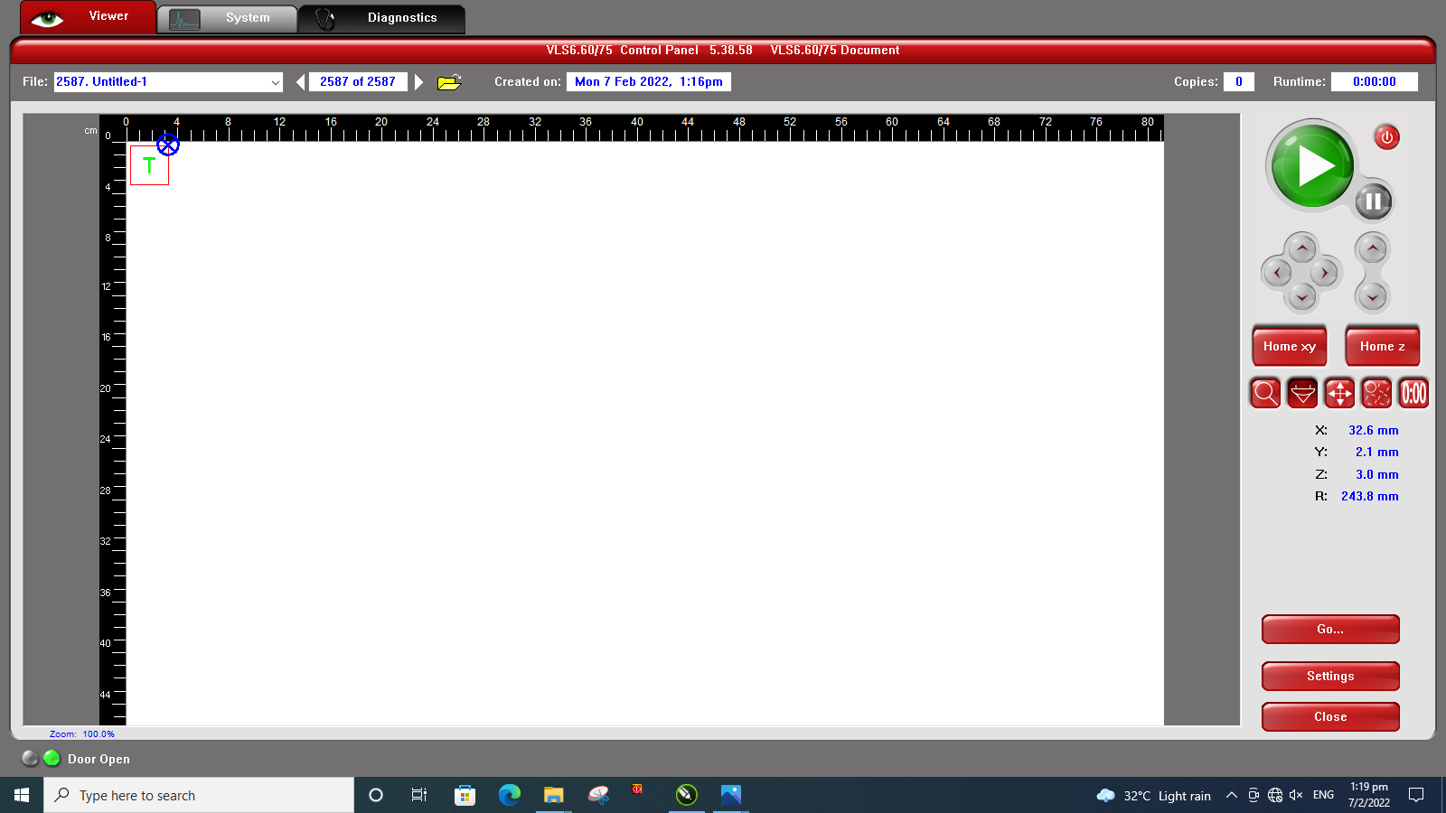
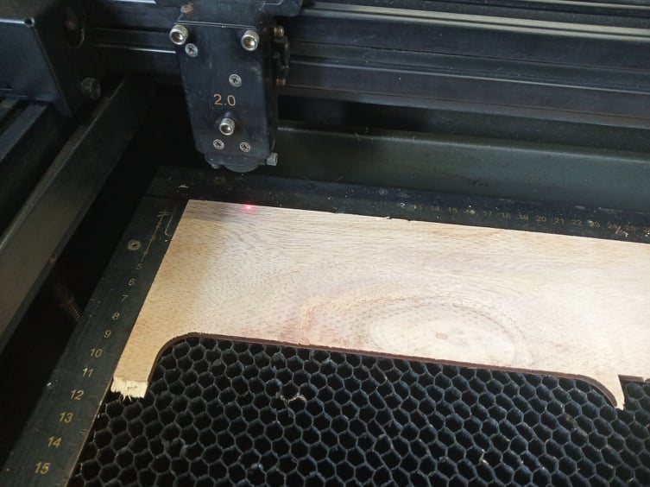
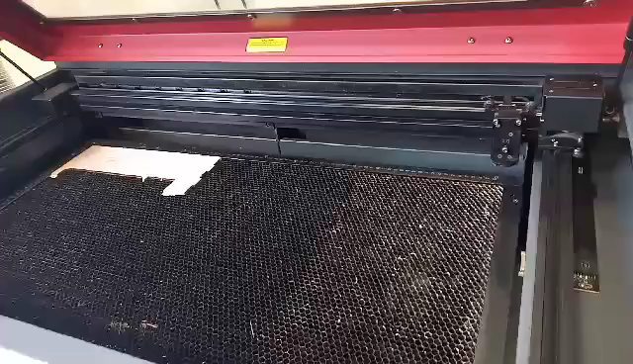
Step 15 (How to See the Position of the Drawing on the Material)
Just click “Focus View” then click anywhere on the machine bed, the laser pointer will move to the mark.

Slide 18
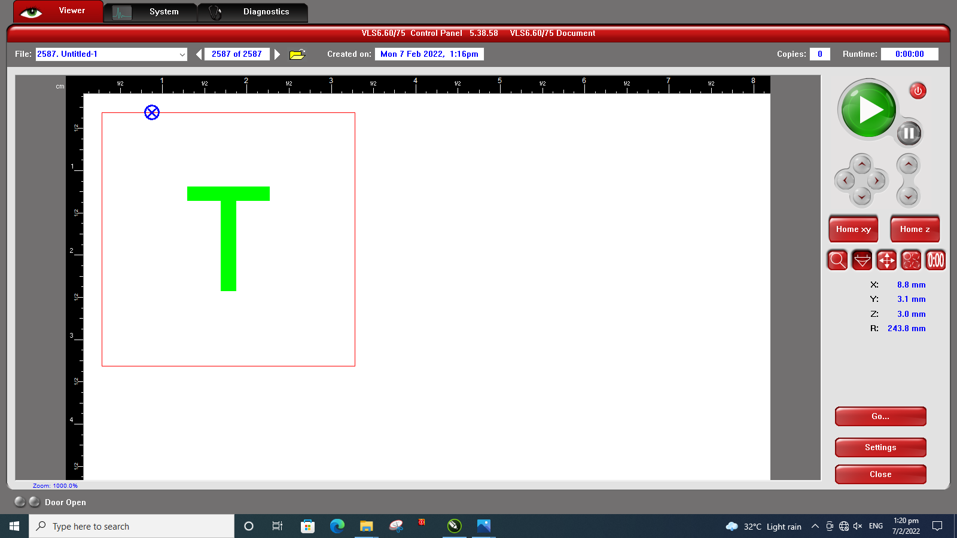
Step 16 (How to Move the Drawing to the Desired Location)
Using “Focus View”, select a point on canvas where you want to move the drawing.
Always check the drawing size and positioning to make sure the it is on the material.

Slide 19
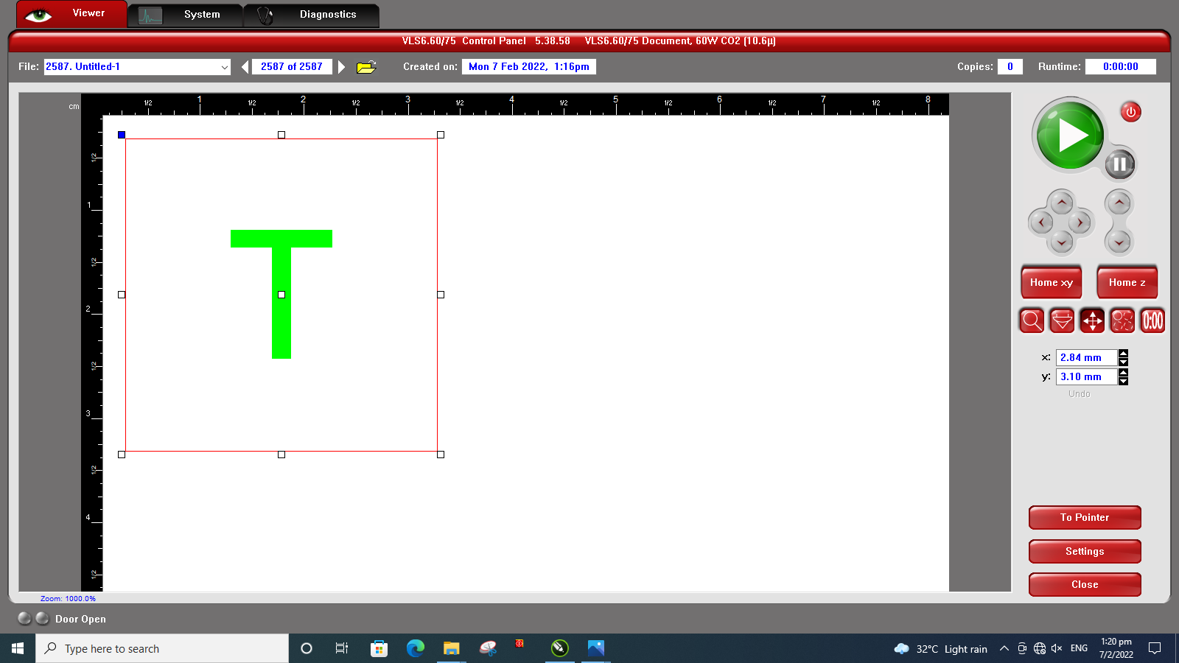
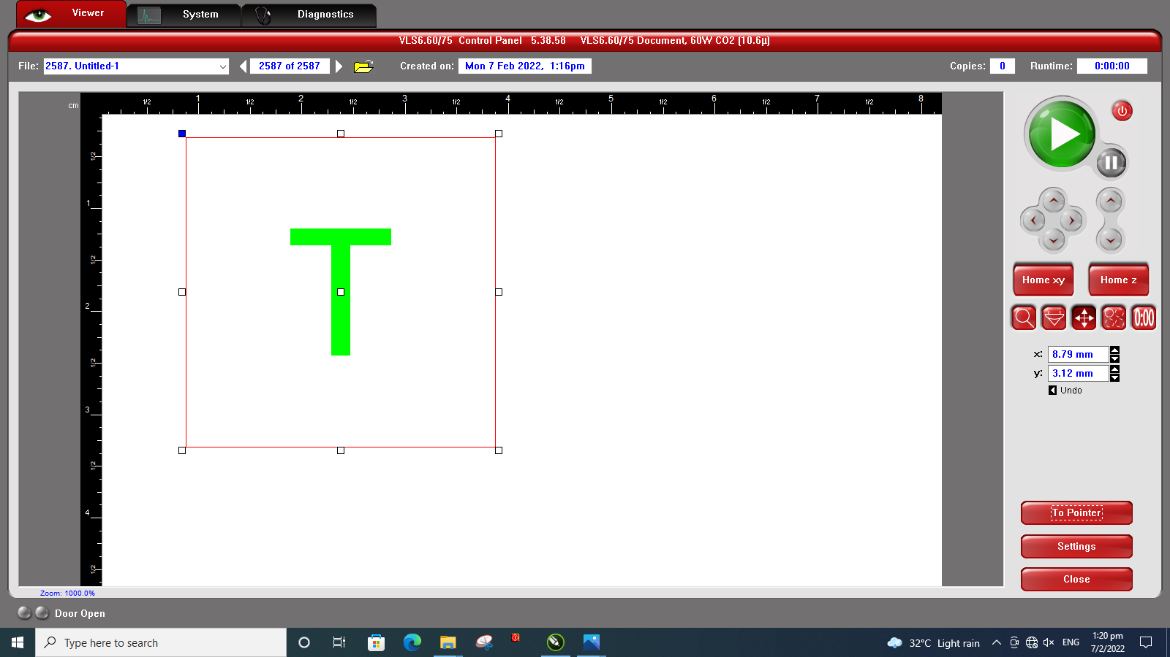
Step 17
Then click “Relocate View” and then click “To Pointer”. The selected node will be moved to the point that you have selected previously. By default, the top left corner of the node has been selected. You can also select the other nodes to move to pointer.
NODES
1
RELOCATE VIEW
SELECTED NODE
2
TO POINTER
Selected node has been shifted to the pointer.
Drawing has been moved from the original position.

Slide 20
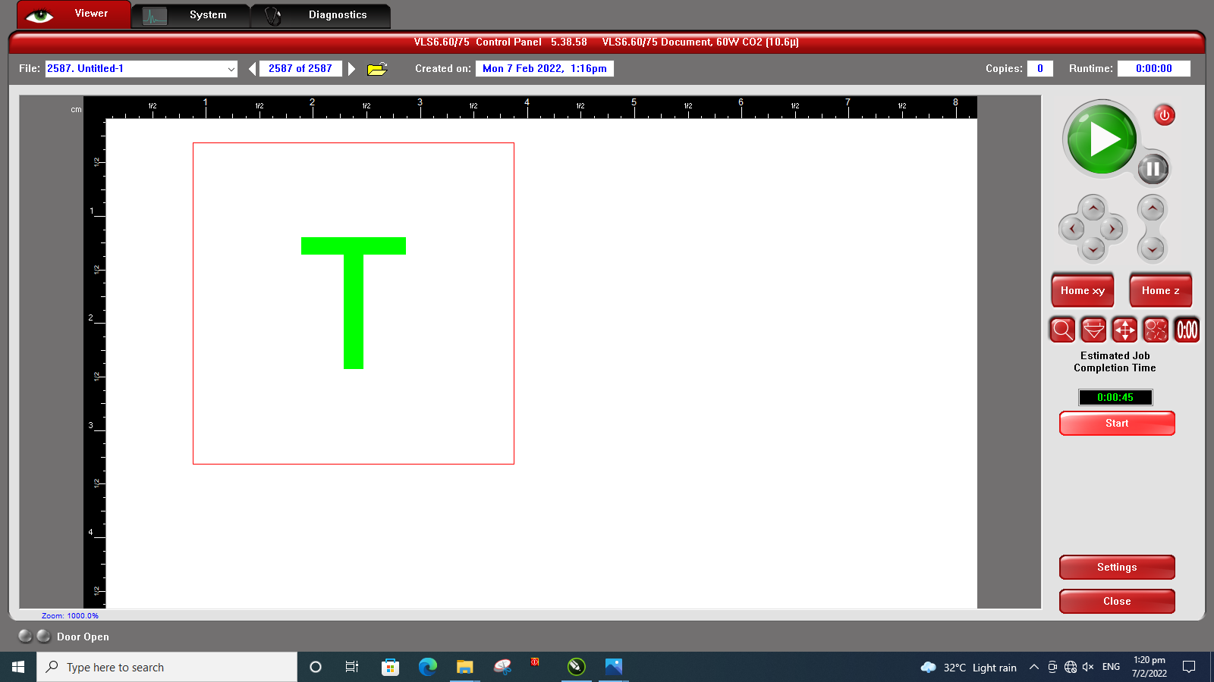
Step 18
“Estimate Job” can be used to see how long the cutting will be. The time estimated is accurate most of the time.

Slide 21

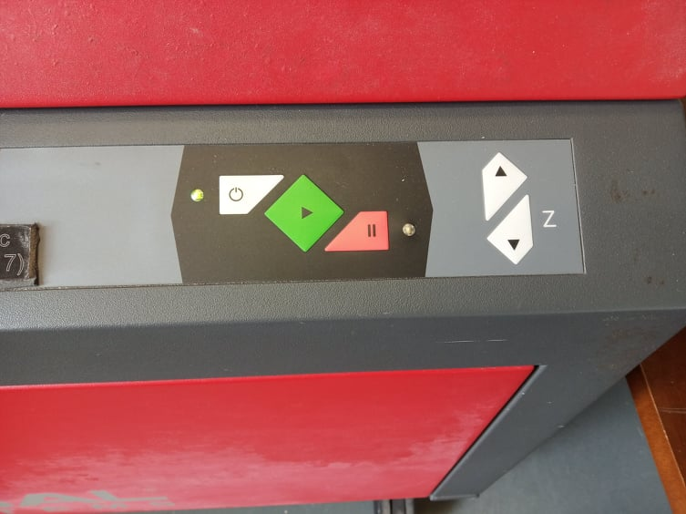
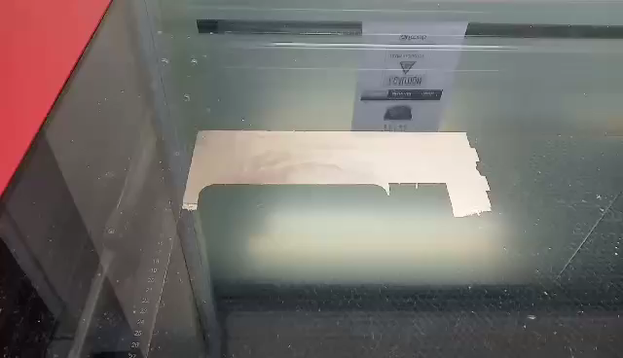
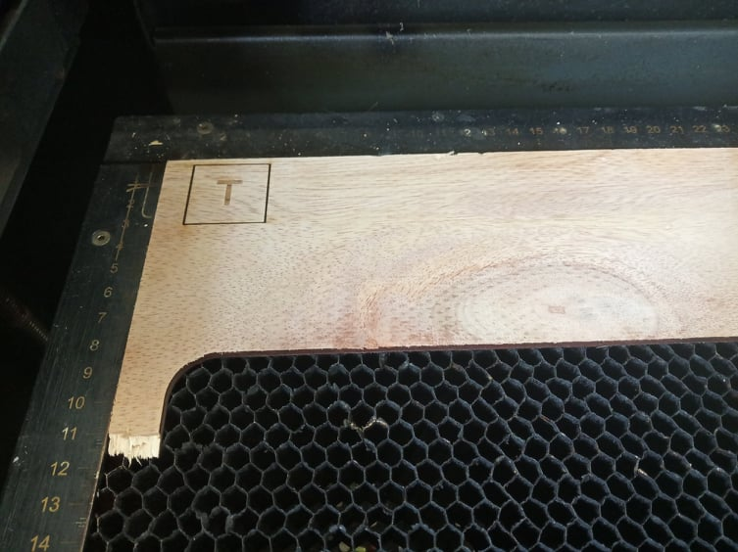
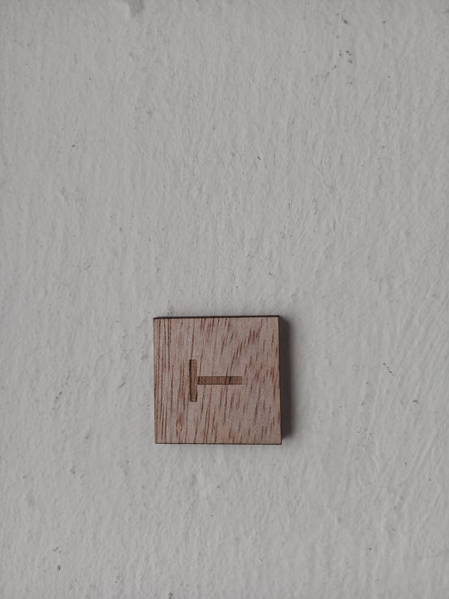
Step 19
After everything is set, you can start cutting. You can click either the play button in the program or the green button on the laser cutter. Make sure that the cover of the laser cutter has been closed before cutting. Otherwise, it will only perform an air-cut.

Slide 22
Precautions to take note while using laser cutter-
Do not stare at the laser for long periods of time. Exposure to radiation can damage your eyes.
Do not leave the laser cutter unattended during operation. Laser produces a lot of heat. Fire can break out during cutting and engraving process.
When you see flames during laser cutting, open the cover quickly, which will pause the process, and take out the fire.
After cutting is finished, do not open the cover immediately. Wait for about 10-20 seconds for the smoke to clear.
When cutting acrylic, peel off the top sheet. If you cut with the sheet, the sheet can catch fire.
Do not slam shut the laser cutter cover. Slowly pull it down.
If you encounter a problem, find the staff in charge or a lecturer. Do not try to resolve the issue if you are not familiar with the laser cutter.
Note:
Fail to follow the rules and precautions can cause in injury and property damage. You will also be banned from using the equipment for a certain period of time.

Slide 23
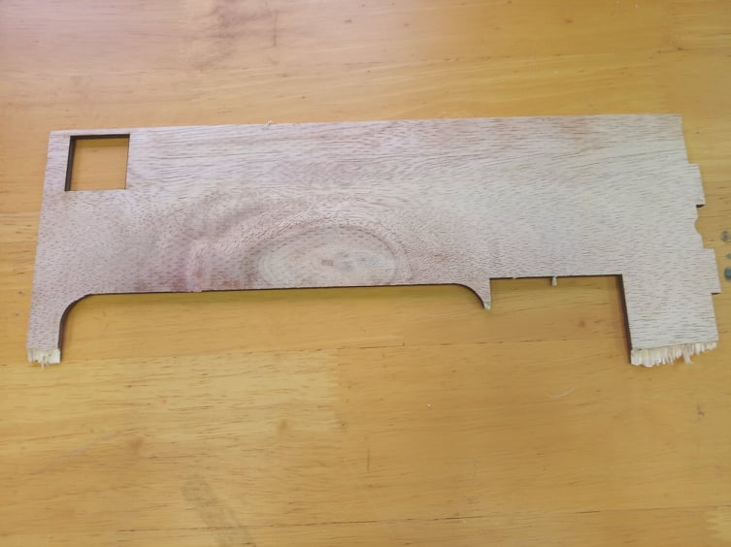
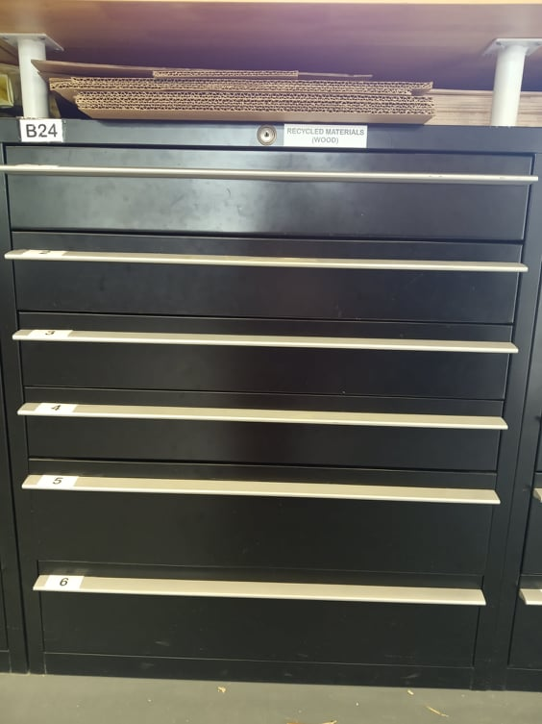
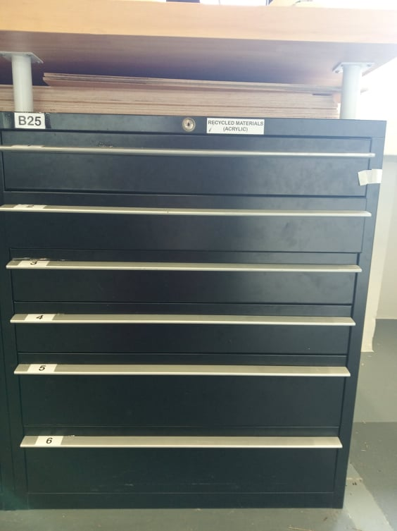
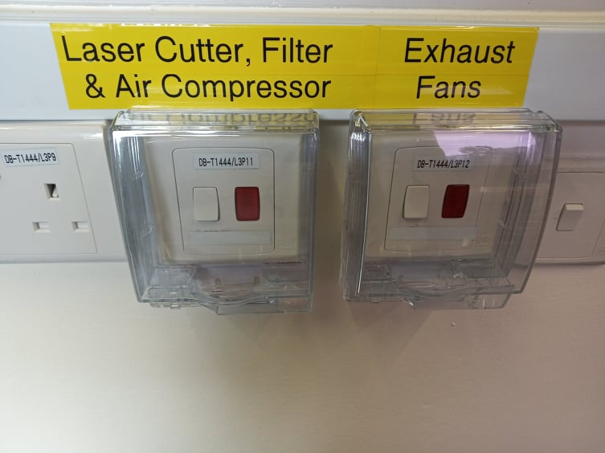
Step 20 (After Laser Cutting)
Make sure that you have-
Cleared away all the scraps and pieces in the laser cutter
Put down the cover of the laser cutter
Put back the material in the dedicated recycle materials drawers
Throw away all trash and materials that cannot be recycled
Switched off the main switches of laser cutters and exhaust fans
B24 – Recycled Materials Drawer for Wood
B25 – Recycled Materials Drawer for Acrylic

Slide 24
End of Guide
Thank you

